Slide 1
Pointers

Slide 2
Pointers
A pointer is just another variable type.
But instead of holding data, it holds the memory address where the data is stored.
The memory location that the pointer references can be changed while the program is running.
Pointers are “typed” so that they know what type of data they are pointed at – you can have a pointer to any valid data type, including classes you wrote.

Slide 3
Creating pointers
To declare a pointer variable, we use the type of the data we want to refer to and then place an asterisk (*) before the variable name
int * intPtr;
As with references in function parameter lists, the whitespace doesn’t really matter – these are also valid:
int* intPtr;
int *intPtr;
However, the * is associated with the variable name. If we declare more than one pointer on a single line, we need an * with each name
int * ptr1, ptr2; ← creates and integer pointer (ptr1) and an integer variable (ptr2)
int *ptr1, *ptr2; ← creates two pointers

Slide 4
Initializing pointers
Pointers are often initialized by giving them the address of another variable using the reference operator (&):
int someNumber = 42;
int * intPtr = &someNumber;
Placing an & in front of a variable tells the compiler to the variable’s memory address. This is then assigned to the pointer.

Slide 5
Using (Dereferencing) a pointer
If we just use a pointer variable, what will be given is the address it points to (this is the value the pointer variable holds)
This is usually not what we want.
To retrieve the value in the memory location the pointer is storing, we need to “dereference” the pointer using the dereference operator, the asterisk (*)
cout << intPtr; ← prints out the memory address
cout << *intPtr; ← prints the value stored in that memory address

Slide 6
Dereferencing Pointers
Once we’ve dereferenced the pointer, it works just like any other variable of the given type
*intPtr is just an integer
If we declared Book * bookPtr;, *bookPtr would just be a Book object

Slide 7
Null & nullptr
Just like primitive data types, when you declare a pointer variable, the “memory address” it points it is just the random values that are in the memory allocated for it. You need to initialize it.
If you aren’t initializing it immediately, you should initialize it to null, or nothing
int * intPtr = NULL; ← old way
int * intPtr = nullptr; ← new way
This makes sure the pointer isn’t point somewhere random and you can explicitly check to make sure the pointer has value before you actually use it.

Slide 9
Pointers and functions

Slide 10
Pointers and Functions
Pointers are just another variable type and can be passed to functions just like any other type
void SomeFunction(int * intPtr);
By default, they are passed by value and a copy of the memory address is given to a local pointer variable
Any change made to the object pointed to will be changed in the calling function
If you change the object the pointer points at, this will NOT be reflected in the calling function

Slide 11
Pointers and Functions
If you want to change the object the pointer is pointing at and have that reflected in the calling function, you must pass the pointer by reference
void SomeOtherFunction(int* & intPtr);
The ampersand (&) has to come after the asterisk (*)
You can still change the original object pointed to and have the change reflected in the calling function
You can also have the pointer reference a new object and have that change reflected in the calling function

Slide 12
Pointers, functions, and CONST
If you have a function with a pointer parameter, that shouldn’t change the object the pointer is referencing, you can explicitly declare this with the const keyword.
void SomeConstFunction(const int * intPtr);
This tells the compiler that you are intending the object to remain constant. The compiler will enforce this and give you an error if you write code that would change the object.

Slide 13
Some common Pointer Errors
Syntax Errors
Using the deference operator when initializing the pointer
*intPtr = &someInt; ← this doesn’t work; you shouldn’t have the leading *
Forgetting the * when declaring multiple pointers on a single line
Runtime errors
Dereferencing a pointer that hasn’t been initialized
Dereferencing a null pointer
Forgetting to pass a pointer by reference when you want a function to change its target object

Slide 15
Dynamic Memory allocation

Slide 16
Dynamic Memory Allocation
When we declare a variable as part of our code, the memory is set aside at compile time and is static, it never changes.
However, this isn’t always what we need. Often, we don’t know at compile time exactly how much memory or how many objects we’ll need.
Dynamic memory allocation allows us to create variables and allocate memory as the program is running based on the needs of the program.
This is achieved with the new and delete operators

Slide 17
New
To tell the program to allocate memory for a variable, we use the new operator.
The new operator takes as its parameter the type of the variable you want to create:
new int;
The new operator returns the memory address of the variable created. You need to capture this in a pointer of the appropriate type
string * sPtr = new string;

Slide 18
Delete
Once we’re done with a variable that we created dynamically, it is up to us to release the memory back to the computer.
This is done with the delete operator, which is passed the name of the pointer variable that holds the address of the variable we want to delete
delete sPtr;
Once you delete a variable, you should always set the pointer to null
sPtr = nullptr;

Slide 19
New and delete with arrays
Remember that for statically allocated arrays, the size of the array had to be a literal or constant variable
This restriction is lifted on dynamically allocated arrays:
int arraySize = 10;
double * arrayPtr = new double[arraySize];
To delete an array, you have to use a special form of the delete command
delete [] arrayPtr;

Slide 20
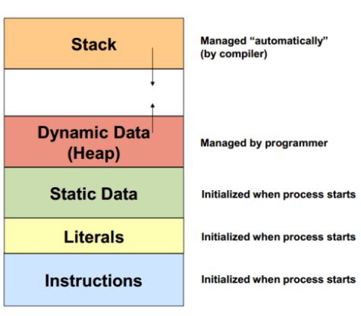
mEMORY
When a program is running there are four major memory regions that it works with:
Code – the machine instructions are stored here
Static memory – literals, global, and static variables – these don’t change
Stack – local variables for functions are created here as the functions are called
Heap – the large unused portion of the computers memory where the new operator goes to create variables when called

Slide 21
Memory Leaks
A couple of common mistakes are
Forgetting to delete memory allocated with new and assigning a new variable to the pointer - losing any reference to the old variable
Deleting an object that dynamical allocated memory – the object is gone but the variables it created are still floating around with no references
These are called memory leaks – the memory is allocated but you have no reference to it and it just sits there taking up space in the computer’s memory
For short, small programs, this may not be a problem but for large or long running programs, this can result in the program being slow and/or crashing.

